Slide 1
Grossmont Website Redesign
Preliminary Project Wireframes - Version 1
December 6, 2013

Slide 2
Terms & Definitions
Accordion-- Specialized content area that opens to display information in expand/contractible rows. This feature is available in the standard and landing page templates; please see applicable slides in the wireframes for examples.
Bucket-- Specialized content area to display information in boxes with headings and specifically sized photos. This feature is available in the standard and landing page templates; please see applicable slides in the wireframes for examples.
Business Requirements– This document defines the high-level needs and features of the project by focusing on the capabilities needed by the Stakeholders of the project and the Target Users.
CMS / Content Management System– CMS is a term for software that allows you to maintain the content of your site without affecting the graphical templates and/or having to know HTML code. There are many packages in this space, in a wide range of price points, but Beacon has selected “Cascade Server” for its content management system and is a close partner with its developer– Hannon Hill. Several members of Beacon’s staff work closely with Hannon Hill on product reviews, suggestions and enhancements and Justin Klingman speaks annually at their user conference.
Content-- All text, images, tables, photos, etc. that make up the web site, but not the layout or graphical elements such as the background or navigation links.
Content Matrix– This document itemizes every page in the new site and its relationship to other pages in the navigational structure as well as the source of the content to populate the new page (usually either a URL of the current website page OR a Word document containing rewritten content).
Features– Specific functionality available within one or more templates. For example, the ability to display an interactive Google Map is a “feature” available in the standard and landing page templates.
Graphical Design– Graphics and color scheme that make up the visual appearance of the website. The new graphical design of the Grossmont and Cuyamaca websites was approved before Beacon Technologies was involved in the project and was used as the basis for the development of the mini sites.
iFrame-- An HTML page or application embedded within the content area of the new website design. Allows content editors to display information or data housed outside of Cascade within the website. However, the source page should not contain any navigational or
Layout / Page Layout– The way the different elements on the page are arranged, including header, footer, content areas, navigation, etc.
Responsive Design– Used to address the ever-changing landscape of devices, browsers, screen sizes and orientations, responsive design incorporates flexible, fluid and adaptive page layouts that adapt to almost any screen size.
Site Hierarchy– A design document representing a general organizational structure of the top two or three tiers of the site in a hierarchical / flow-chart type format.
Spectate– Software that integrates with Cascade Server that allows content editors to create web-based forms to be displayed on their web pages.
Template– A unique page layout available within Cascade Server. A template is the basic shell with some standard and optional features for a page. It is used to create specific pages while maintaining a consistent “look” across the internal pages of the site. Examples of anticipated templates for the Grossmont and Cuyamaca sites are the following (which will be documented in the forthcoming slides of the wireframes document): Homepage, Landing Page, Standard Page, Faculty, Newsletter, Calendar, News, Committees, Photo Gallery, Page Not Found, Search Results.
UAT (User Acceptance Testing)– Also known as “end user testing,” this is the phase of the project where the client tests the site in a “real world” environment. We have specially designated test servers at Beacon that allow you to view the site exactly as it will appear in Production, without opening it up to the public yet. Depending on the size of the project, we try to reserve at least a week (and usually two or more!) for this process, to make sure that we have met your expectations for the project.
Widget—A reusable feature of a template that can be created in a shared location and used on more than one page. For example, an administrator could create a video widget (including the text title, thumbnail image and Youtube video id of a specific video) in a folder and multiple website editors could select that widget from a list to display it on their page as well, without having to provide all the previously mentioned text, image and video id information.
Wireframes— Also known as “conceptual page layouts,” this is a visual representation the skeletal framework of key elements of the website, including arrangement of the website content, navigational systems, header, footer, etc.

Slide 3
Proposed Site Templates
Home
Landing
Standard
Faculty
News
Newsletters

Slide 4
Home Page

Slide 5
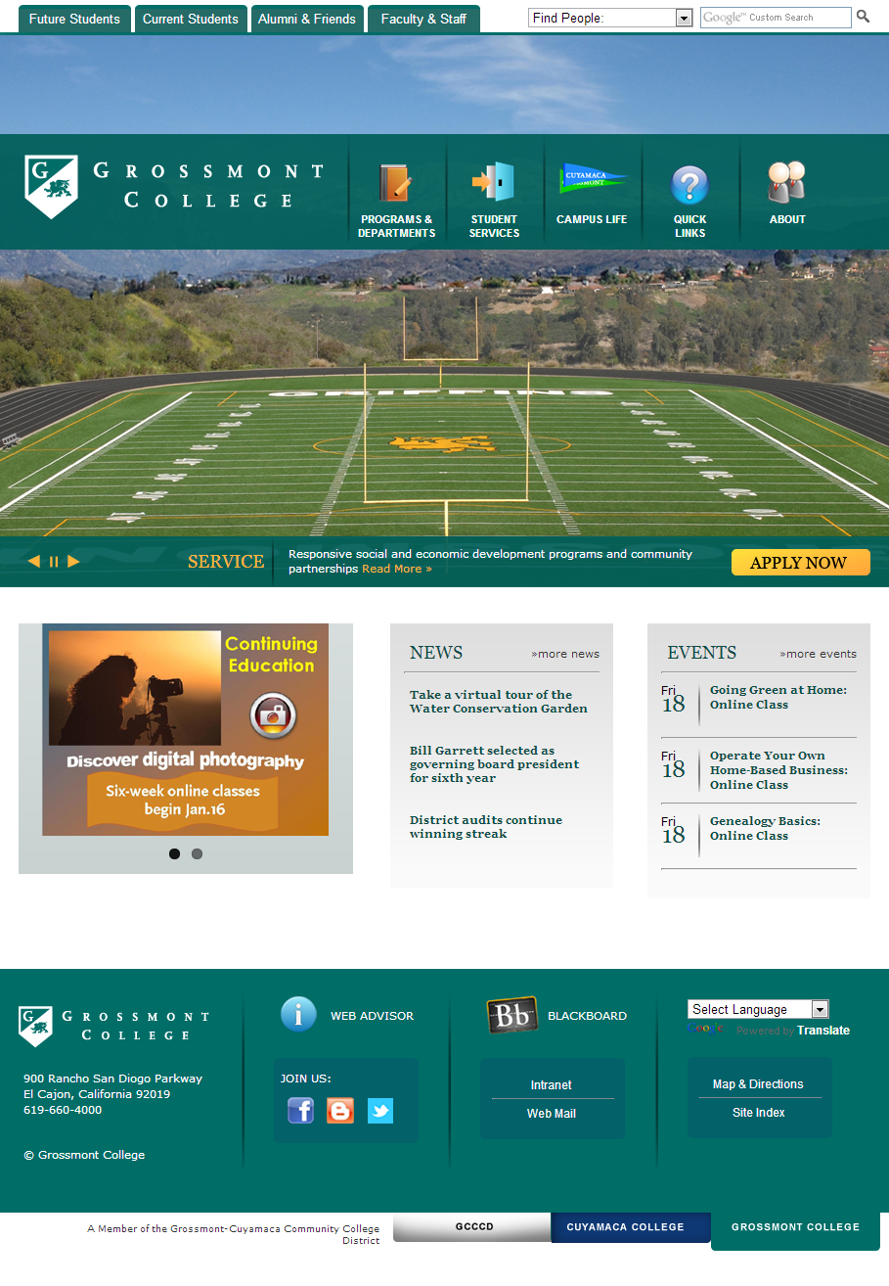
Ability to link “Read More” link in caption text to internal or external page or file
Multiple images with caption text auto-rotate
Featured area auto rotates up to 8 slides. Arrows under slide for navigation.
Opens in same tabs/windows

Slide 6
Drop Menu – Design Option 1 (Tier 2 pages only)

Slide 7
Drop Menu – Design Option 2 (Tier 2 and 3 pages)

Slide 8
Landing Page

Slide 9
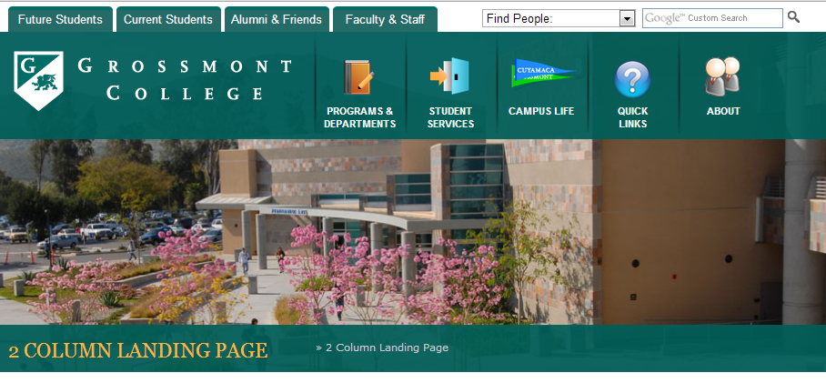
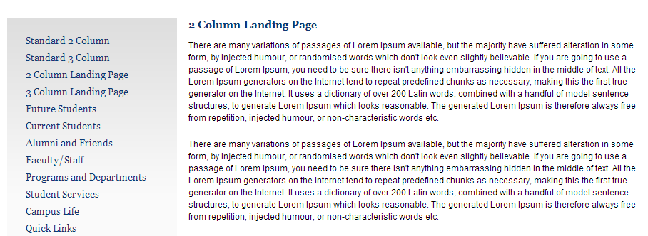
Large banner image above page title is only difference between landing and standard templates – Generally used for major section home pages like “Admissions”

Slide 10
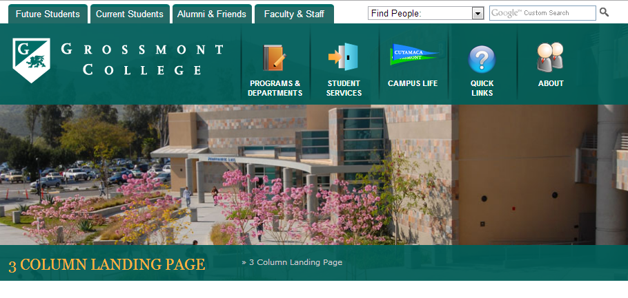
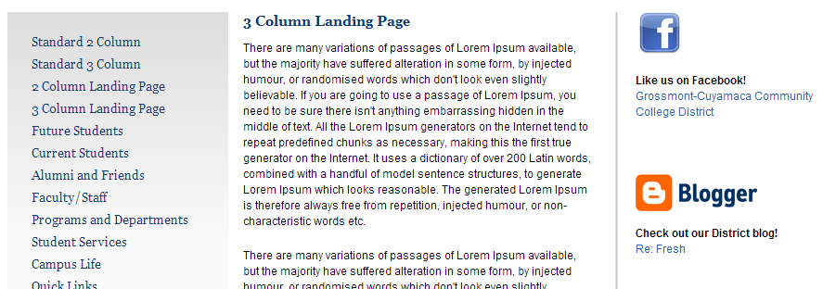
Landing page with optional right column

Slide 11
Standard Page

Slide 12
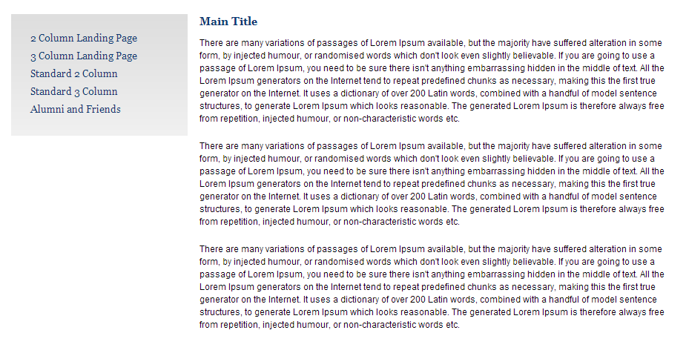
Standard 2-column page with no optional features enabled

Slide 13
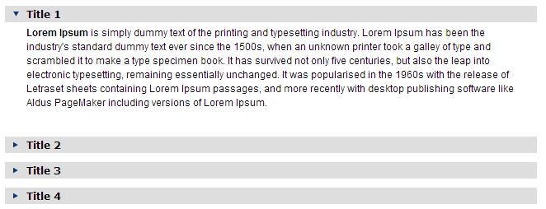
Standard 2-column page with accordion enabled

Slide 14
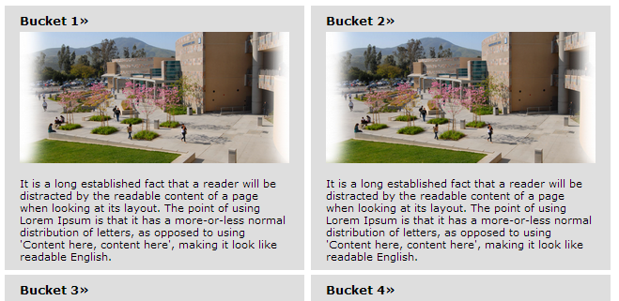
Standard 2-column page with buckets enabled

Slide 15
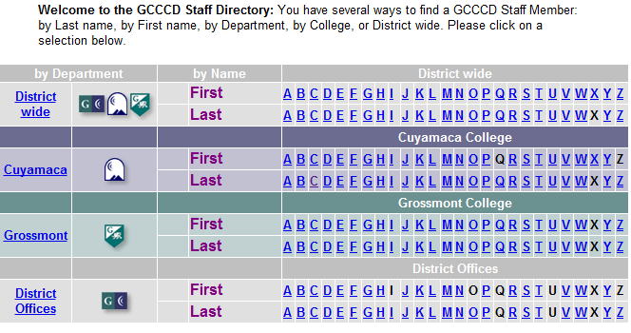
Standard 2-column page with iframe enabled (3rd party application)
Directory
Intro text (within Cascade page…

Slide 16
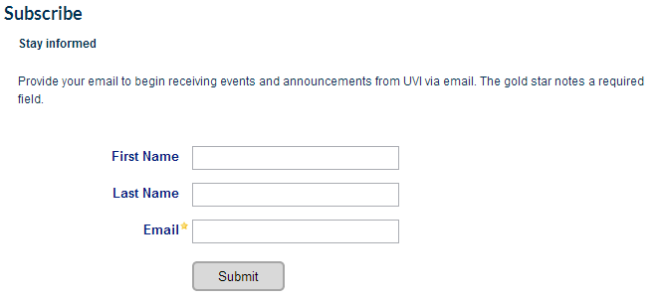
Standard 2-column page with Spectate form enabled

Slide 17
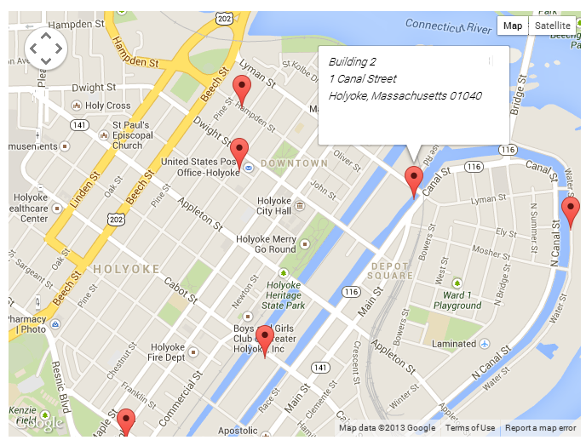
Standard 2-column page with Google map feature enabled. Latitude, Longitude, Address and Pop-up text entered in Cascade.
Our Campus
Here is some introductory text about our campus. See the map below for more information…

Slide 18
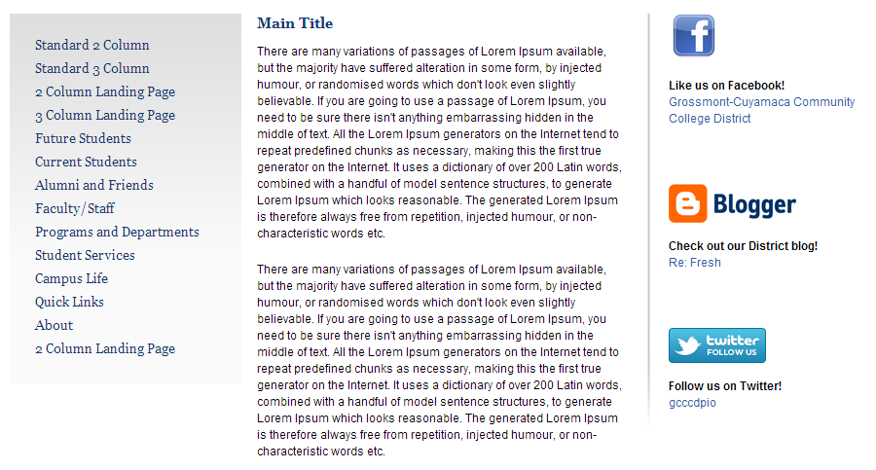
Standard page with optional right column

Slide 19
Faculty Pages

Slide 20
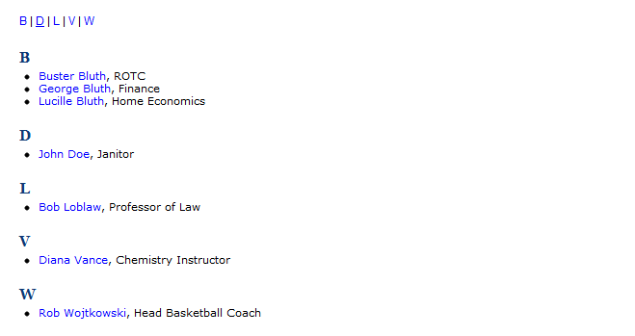
Academic Programs
Programs of Study
Transferability
Courses
Continuing Education
Online Courses
Our Faculty
College Catalog
Academic Calendar
Our Faculty
Introductory text here…
Introduction
This is descriptive introductory text about this professor. The quick brown fox jumps over the lazy dog. The quick brown fox jumps over the lazy dog. The quick brown fox jumps over the lazy dog. The quick brown fox jumps over the lazy dog. The quick brown fox jumps over the lazy dog.
The quick brown fox jumps over the lazy dog. The quick brown fox jumps over the lazy dog. The quick brown fox jumps over the lazy dog. The quick brown fox jumps over the lazy dog. The quick brown fox jumps over the lazy dog.

Slide 21
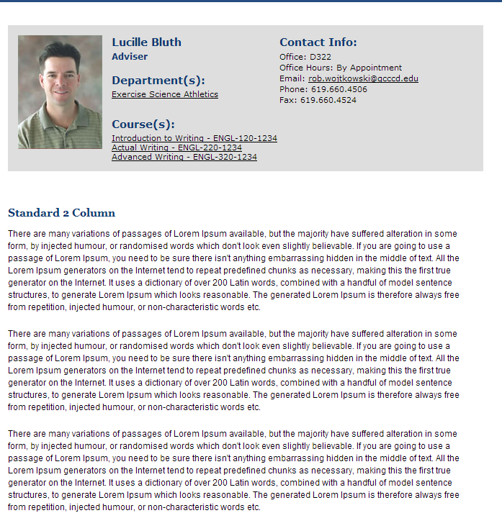
Standard Faculty info box displayed at the top of all faculty pages
Academic Programs
Programs of Study
Transferability
Courses
Continuing Education
Online Courses
Our Faculty
Lucille Bluth
Introduction
Class Schedule
Study Guides
Demo Day
Test 1
Test 2
Exercise Tips
Personal Website
College Catalog
Academic Calendar
Below Top Box to include WYSIWYG for additional info such as an Introduction or Biography

Slide 22
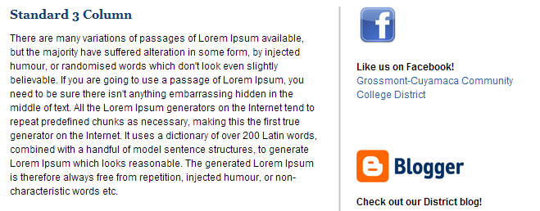
Academic Programs
Programs of Study
Transferability
Courses
Continuing Education
Online Courses
Our Faculty
Lucille Bluth
Introduction
Class Schedule
Study Guides
Demo Day
Test 1
Test 2
Exercise Tips
Personal Website
College Catalog
Academic Calendar
Ability to create and/or link to unlimited number of sub pages in left navigation, external websites or files (PDF, Word, etc.)
Faculty sub-page example

Slide 23
News

Slide 24
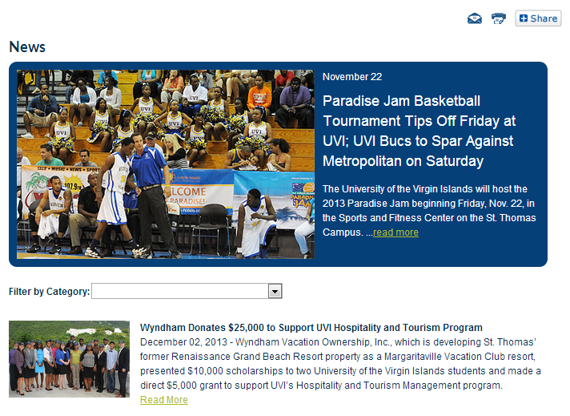
About Library
About
Fast Facts
Our Campus
Policies
Message from the President
Mission & History
Accreditation
Support Grossmont/Cuyamaca
Directory
News

Slide 25
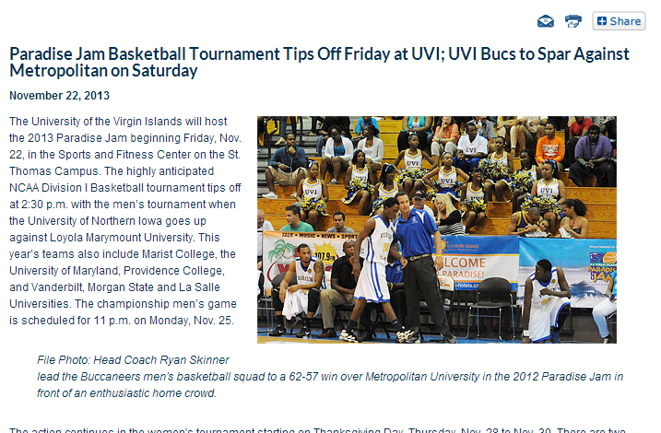
About Library
About
Fast Facts
Our Campus
Policies
Message from the President
Mission & History
Accreditation
Support Grossmont/Cuyamaca
Directory
News

Slide 26
Newsletters

Slide 27
About Library
About
Fast Facts
Our Campus
Policies
Message from the President
Mission & History
Accreditation
Support Grossmont/Cuyamaca
Directory
Newsletters
Newsletters
E-Grossmont
Current Issue: Volume 12, July 2012
Previous Issues
- 2012
Volume 12, January 2012
Volume 12, February 2012
Volume 12, March 2012
Volume 12, April 2012
Volume 12, May 2012
Volume 12, June 2012
+ 2011
+ 2010
+ 2009
+ 2008
+ 2007
+ 2006
+ 2005
Each link opens in a new window in the same format as on current site. Past issues displayed in expand/contract-able lists
Campus Scene
Current Issue: Volume 12, Spring 2012
Previous Issues
2011
Winter
Summer
+ 2010
+ 2009
+ 2008
+ 2007
+ 2006
+ 2005

Slide 28
Emergency Status Messages

Slide 29
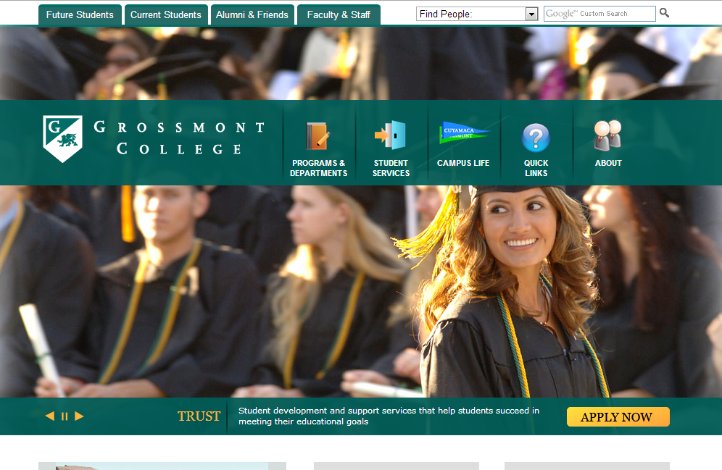
Emergency message option #1: Message appears on every page of the site. Once closed by visitor, is not displayed again to that visitor unless message is changed.

Slide 30
Emergency Alert: There has been a water main break at 1st and Main Streets and all traffic has been diverted.
Emergency message option #2: Message appears on every page of the site. Does not have to be closed by visitor. Same message displayed on every page until turned off or changed by administrator

Slide 31
Emergency Alert: There has been a water main break at 1st and Main Streets and all traffic has been diverted.
About Library
About
Fast Facts
Our Campus
Policies
Message from the President
Mission & History
Accreditation
Support Grossmont/Cuyamaca
Directory
News
Emergency message option #2: Message appears on every page of the site. Does not have to be closed by visitor. Same message displayed on every page until turned off or changed by administrator

Slide 32
Emergency message option #3: Message only displayed on home page. . Does not have to be closed by visitor. Same message displayed until turned off or changed by administrator

Slide 33
Widgets

Slide 34
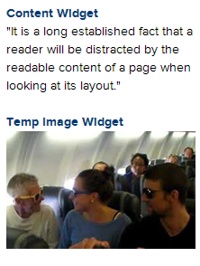
About Library
About
Fast Facts
Our Campus
Policies
Message from the President
Mission & History
Accreditation
Support Grossmont/Cuyamaca
Directory
News
Content and Image widgets. Sharable assets that are created in one location in Cascade by administrators and then all content editors can choose to display on their pages.

Slide 35
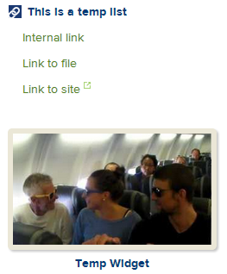
About Library
About
Fast Facts
Our Campus
Policies
Message from the President
Mission & History
Accreditation
Support Grossmont/Cuyamaca
Directory
News
Navigation links and Video player widgets
Sharable assets that are created in one location in Cascade by administrators and then all content editors can choose to display on their pages.

Slide 36
About Library
About
Fast Facts
Our Campus
Policies
Message from the President
Mission & History
Accreditation
Support Grossmont/Cuyamaca
Directory
News
Events and Blog widgets
Sharable assets that are created in one location in Cascade by administrators and then all content editors can choose to display on their pages.

